Slide 1
Diversity
Notes:
1

Slide 2
Diversity (1)
Extreme and rapid signal variations are associated with mobile radio reception
Diversity
reduces these fluctuations (reduces the effects of fading) into a more acceptable range
we have two or more transmission paths that suffer different fading statistics, carrying the same message
i.e. independent/uncorrelated transmission paths
Two or more independent/uncorrelated transmission paths give us the opportunity to select one of them or combine them so we reduce the impact of fast fading.
(0,0)
(1,0)

Slide 3
Diversity (2)
Why effects of fading are reduced?
It is highly improbable that both uncorrelated signals will enter a fade at the same time
If the branches are highly uncorrelated, usually when one enters a signal fade, the other one will most probably have a strong signal
If we monitor the signal strength at the branches, the distortion that results, could be minimised with signal processing
(0,0)
(1,0)

Slide 4
How can we generate those uncorrelated paths???
Space Diversity
Angle Diversity
Time Diversity
Frequency Diversity

Slide 5
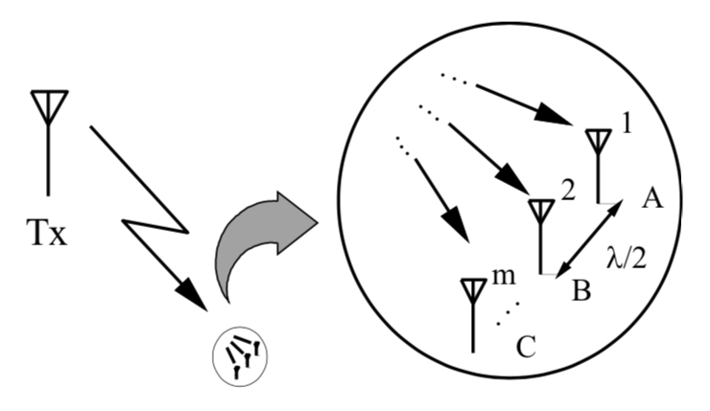
Space Diversity
Also known as Antenna diversity
The transmitted signal is received via a number of different antennas
Antennas are spaced sufficiently far apart to ensure independent and uncorrelated fading
Simple form of diversity, no additional spectrum required
Many applications

Slide 6
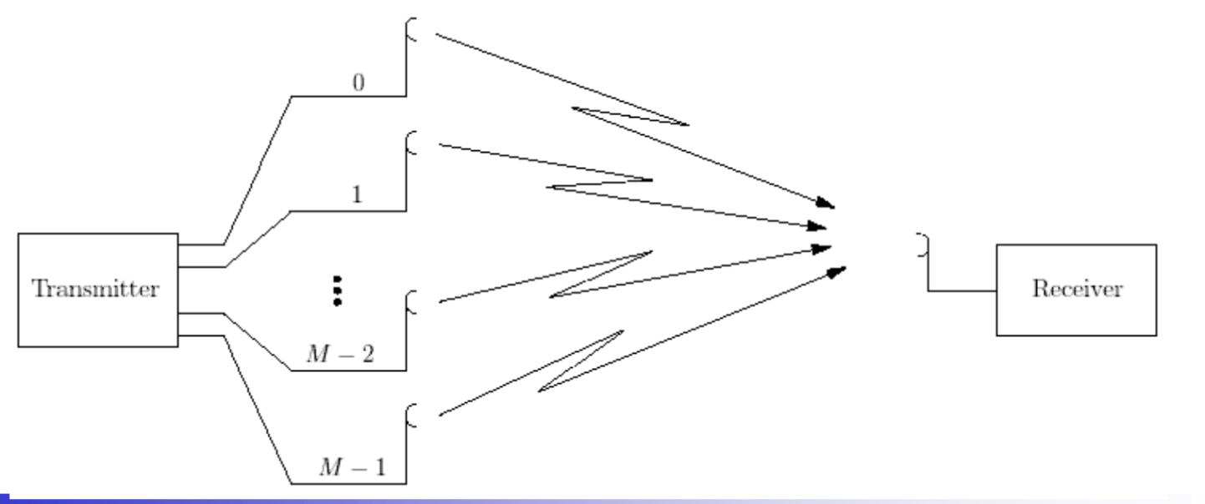
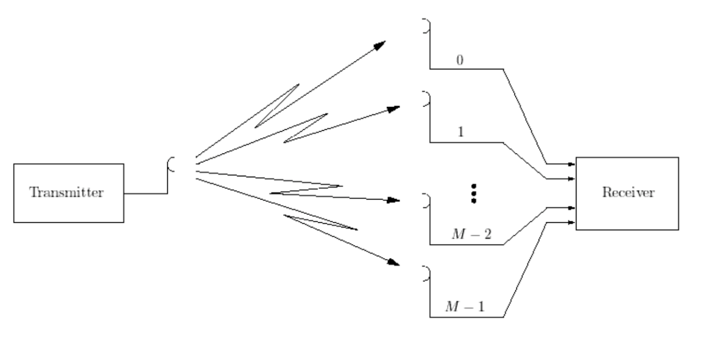
Space Diversity (1)
Transmitter Space diversity
Transmit power is split across the M antennas
Receiver Space diversity

Slide 7
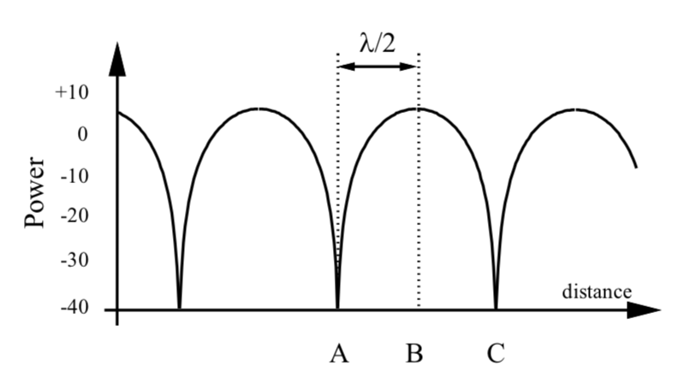
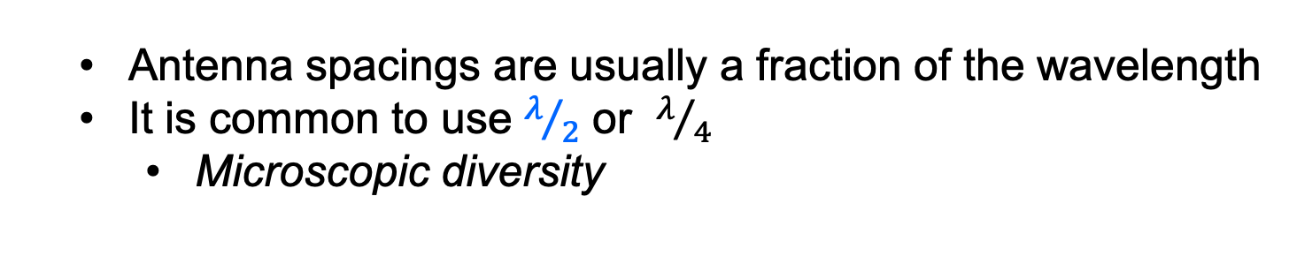
Space Diversity (2)
Receiving antennas should be set such that the signals on adjacent branches are uncorrelated
Antennas spaced at a distance greater than the coherence distance
Antenna spacings are usually a fraction of the wavelength
It is common to use $λ/2$ or $λ/4$
Microscopic diversity
Exploits small scale fading, characterised by deep and rapid amplitude fluctuations as the mobile moves a distance of a few wavelengths

Slide 8
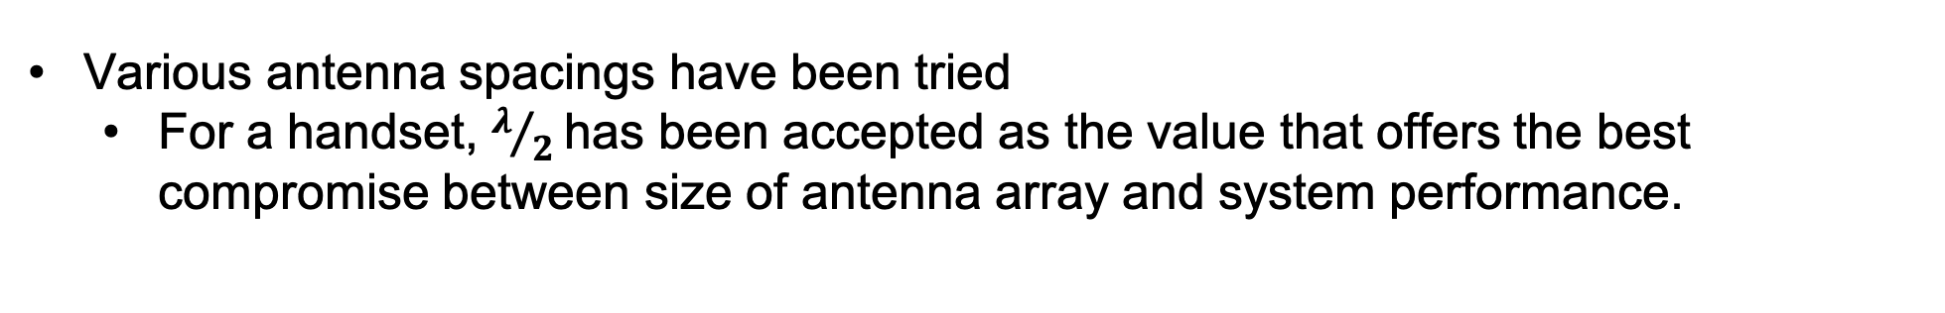
Space Diversity (3)
Various antenna spacings have been tried
For a handset, $λ/2$has been accepted as the value that offers the best compromise between size of antenna array and system performance.
Factors affecting the choice of antenna spacing:
Determined by the spaced-distance correlation function
Function of the multipath power and the angle spread
The narrower the angle spread, the wider the required spacing
due to the similar type of multipaths (eg. Reflection from one wall)
Optimum spacing depends on the azimuth angle spread of multipaths, which influences the Doppler spread
The angle spread depends on the specific environment

Slide 9
Space Diversity (4)
If antennas are mounted at a roof height
The majority of energy is arriving from the location of the terminal (specific direction)
Thus the angle and doppler spread are low, and the required spacing needs to be larger (2-3 wavelengths)
No increase in transmitted power and bandwidth required
Coherent combining of the uncorrelated signals, results in an increase in the received SNR

Slide 10
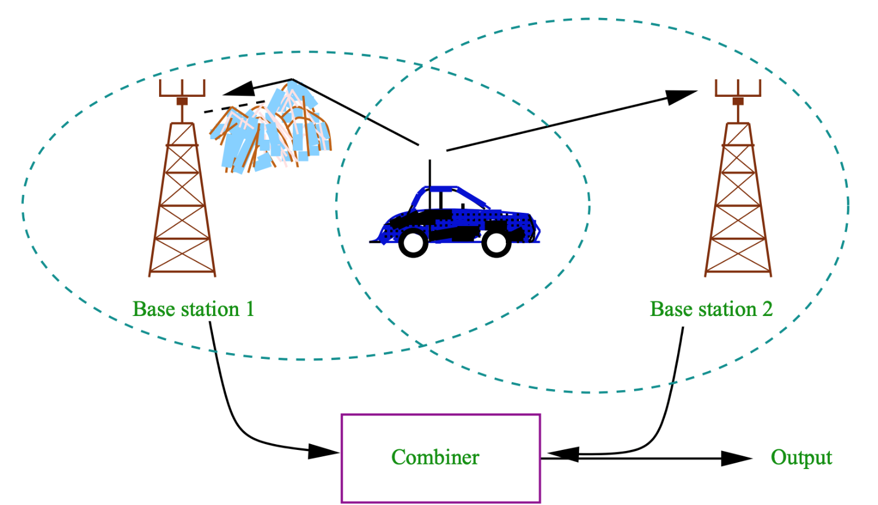
Space Diversity – Macroscopic Diversity
Exploits large scale fading caused by shadowing
Due to variations in the terrain profile and nature of the surroundings
Choose a basestation, which is not shadowed, to have the best SNR at the forwarded link

Slide 11
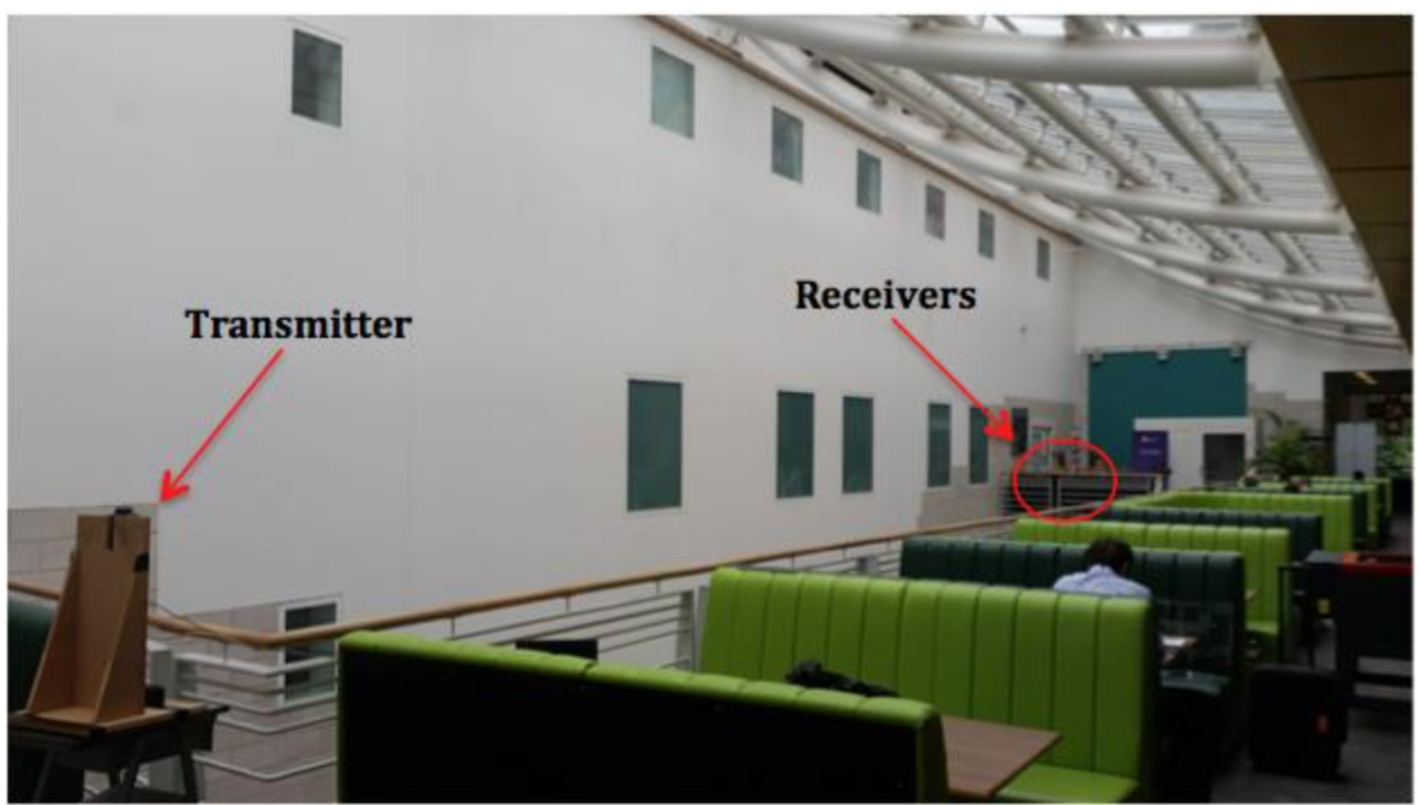
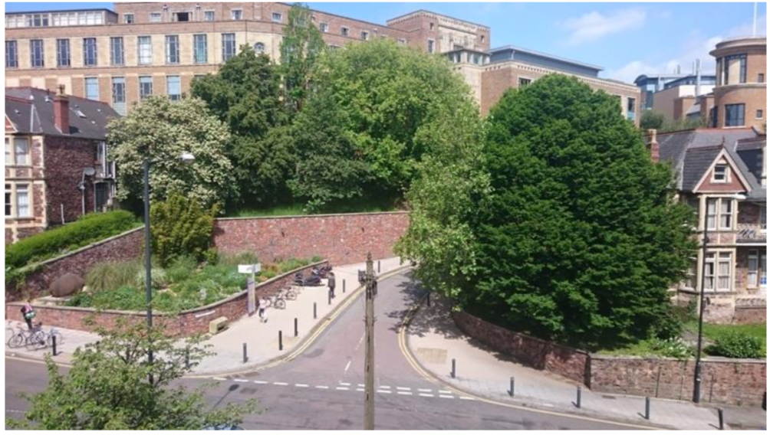
Space Diversity Trial (1)
Indoors and Outdoors (MVB) mmWave (at 60GHz) modem measurements (5G-Xhaul)
Received SNR, Data Rate and Average Packet Delivery rate for different locations and several modulation and coding schemes

Slide 12
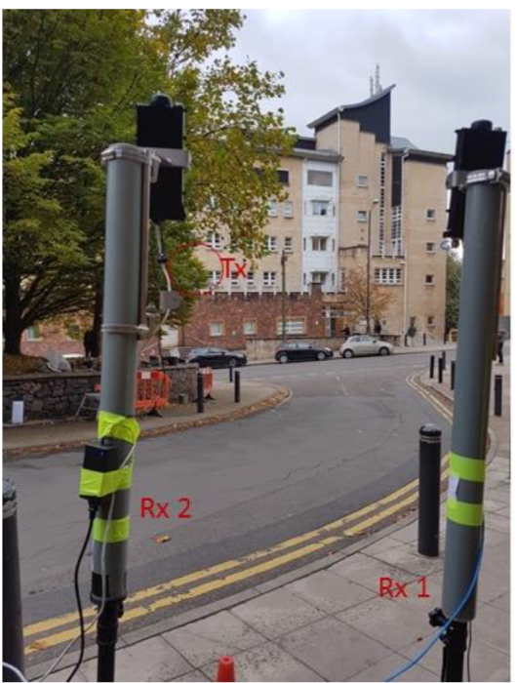
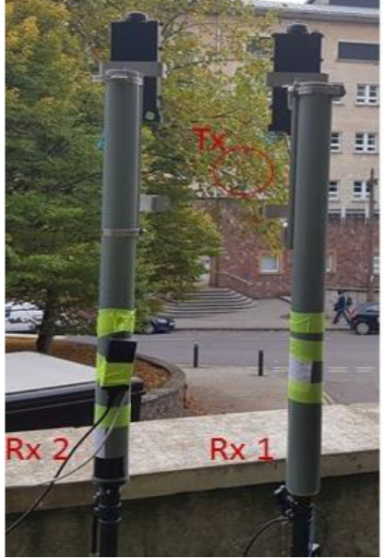
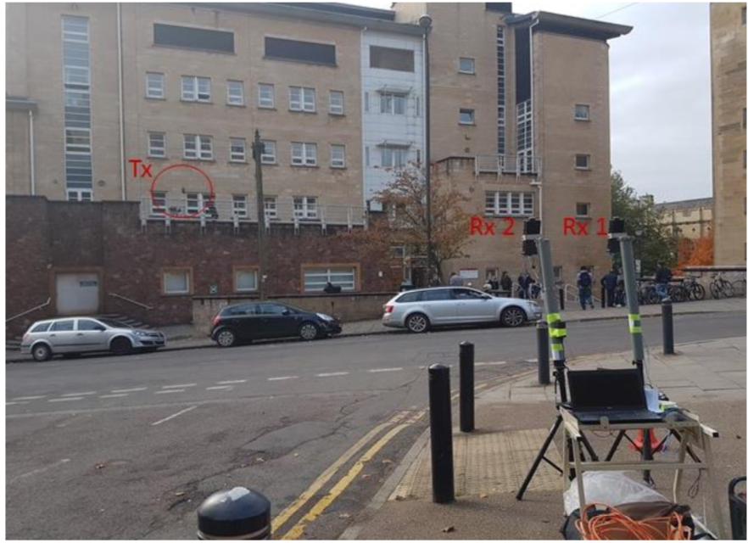
Space Diversity Trial (2)
Indoors and Outdoors (MVB) mmWave (at 60GHz) modem measurements
16cm and 52cm indoors
40cm and 80cm outdoors

Slide 13
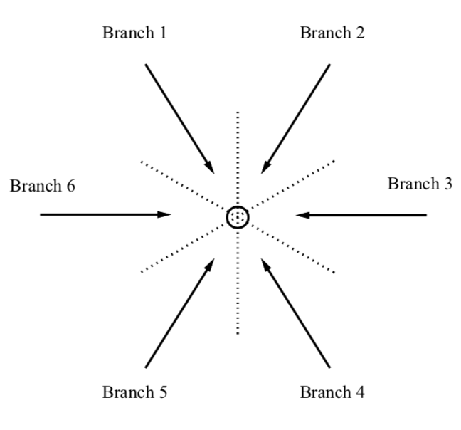
Angle (Pattern) Diversity (1)
Signals arriving from different directions are uncorrelated
So, directive antennas can be used to produce the required independently faded diversity signals
Directive antennas restrict angles over which rays may be received
so the effects of Doppler spread and time delay spread are reduced

Slide 14
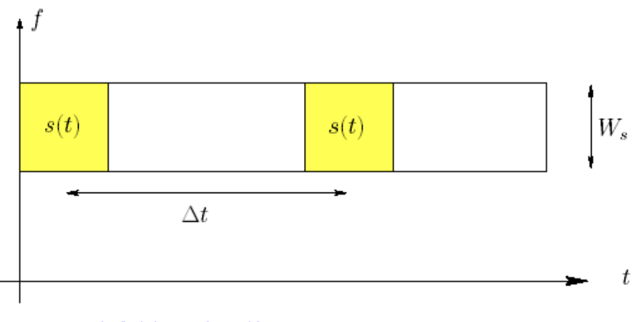
Time Diversity (1)
System operates by retransmitting the message signal after a suitable time delay
Copies of the signal are transmitted over different time periods
Delay should be greater than the coherence time of the channel
Remember in space diversity the antenna spacing should be greater than coherence distance
Transmitted signal: s(t)

Slide 15
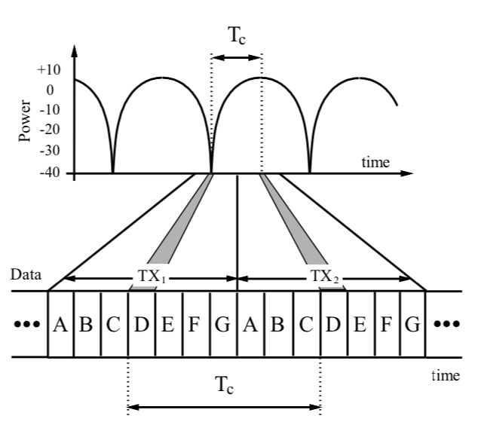
Time Diversity (2)
No improvement if the user is static, although a slight gain can be achieved due to the time-variability associated with other motion in the channel
This method:
Reduces the efficiency
Requires information storage at both ends, introducing delay
unacceptable for audio

Slide 16
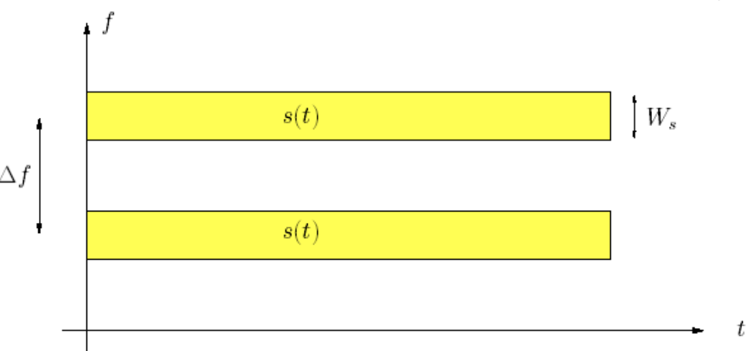
Frequency Diversity (1)
The required signal is transmitted on more than one frequencies
Copies of the signal modulated in different frequencies
Only one antenna is required
Transmit power is split among the carriers
Transmitted signal: s(t)

Slide 17
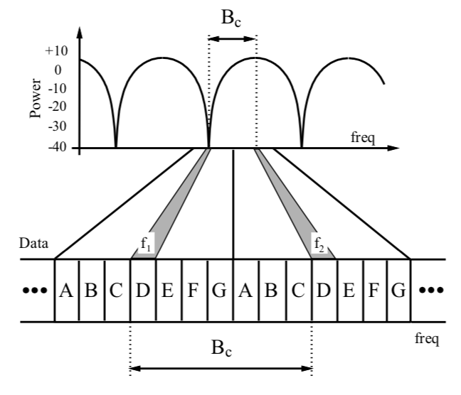
Frequency Diversity (2)
Frequency separation should be enough
to ensure uncorrelated fading, i.e. greater than coherence bandwidth
There is no delay
This method requires extra signal bandwidth, so it is not desirable!

Slide 18
Diversity Combining Strategies
Uncorrelated paths can be combined to improve the resulting signal to noise statistics
In ascending order of complexity, cost and performance, the strategies are:
Switched (Scanning) Diversity
Selection Diversity
Equal Gain Combining
Maximal Ratio Combining
(0,0)
(1,0)

Slide 19
Switched (Scanning) Diversity
Cheap
Simple
requires one circuit to measure the average signal power to perform Received Signal Strength Indication (RSSI)
power at the received signal
The current branch is selected until it fails a given metric. Then, the next branch in turn is blindly selected. If it satisfies the metric, it remains selected, otherwise the system moves on to the next branch

Slide 20
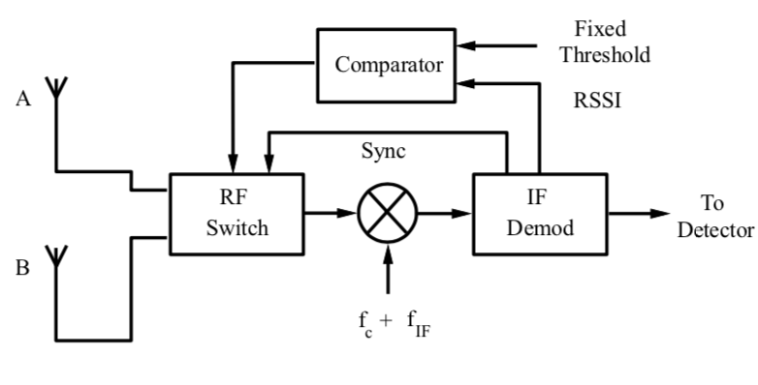
Switched Diversity – fixed threshold (1)
1. Select branch A
Simple metric based on signal strength
2. RSSI: - 10dBm>- 40dBm
- 40dBm
3. Again select branch A
4. RSSI: - 50dBm<- 40dBm
- 10dBm
5. Select branch B
- 50dBm
5dBm
6. RSSI: 5dBm>- 40dBm
-45dBm
7. Again select branch B
8. RSSI: -45dBm<- 40dBm
9. Switch to branch A

Slide 21
Selection Diversity (1)
more complex
more expensive
signal strength on each branch is estimated in parallel
The most appropriate branch or antenna is always chosen from those available
Many techniques to choose a branch, usually the largest RSSI is chosen
Selection combining ensures that the stronger of the available envelopes is always chosen

Slide 22
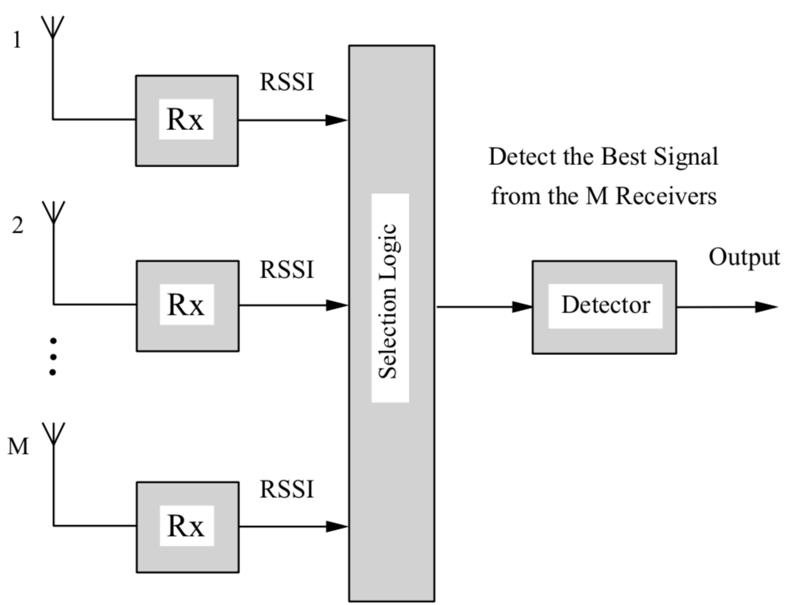
Selection Diversity (1)
Parallel scanning
Selection of branch with higher RSSI or SNR

Slide 23
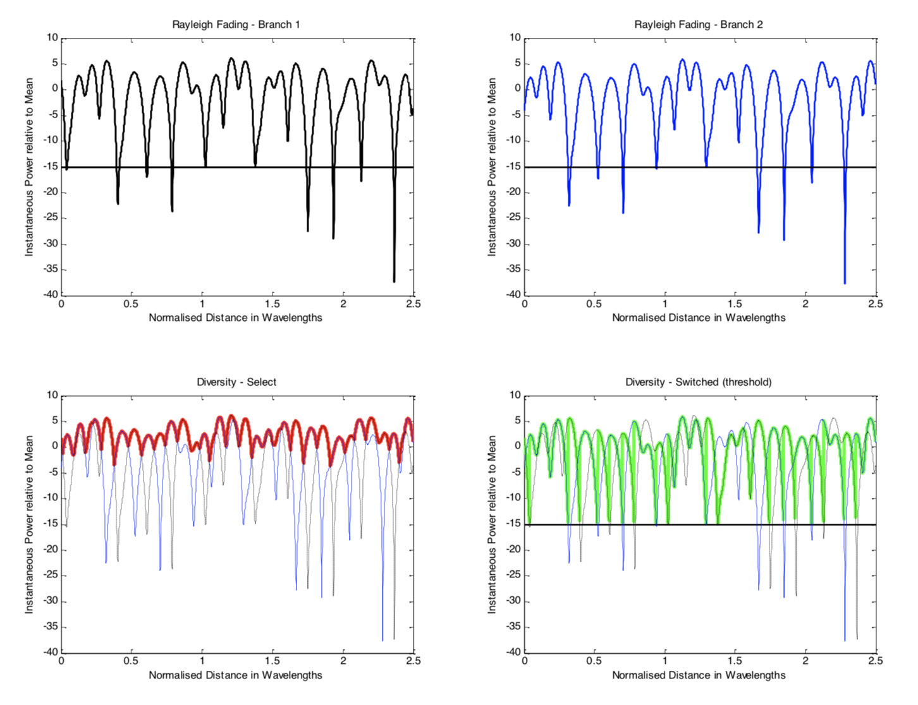
Selection Diversity (2)
Slightly better fading statistics compared to switched diversity
Still we discard signals coming to non-selected branches!

Slide 24
Maximal Ratio & Equal Gain Combining
Both techniques are known as linear combiners
various signal inputs are individually weighted and added
Post-detection combining: if combining takes place after detection
Pre-detection combining: if combining is implemented before detection
It requires co-phasing to be applied before signals are combined, in order to prevent the possibility of destructive summation

Slide 25
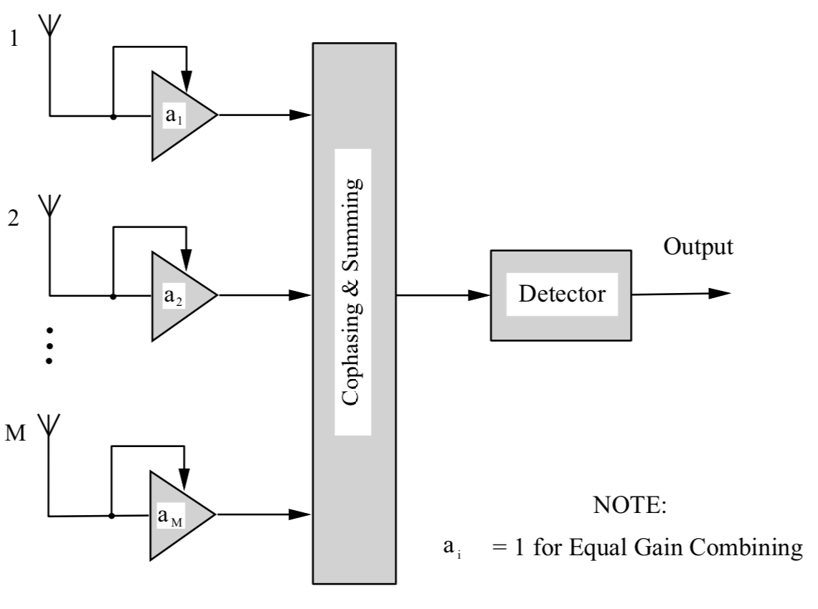
Maximal Ratio Combining
Each branch is weighted before summation in proportion to its own SNR
The resulting output from the combiner is a weighted, co-phased summation of all the diversity branches available at the RX
It optimises the received SNR at the output from the combiner
It represents the optimal combining strategy
maximises SNR

Slide 26
Equal Gain Combining
Simpler approach
Gain of each branch is set to one, and signals are simply co-phased and summed
Sub-optimal strategy, but avoidance of any signal to noise power estimation is highly attractive
Performance is marginally below that for maximal ratio combining
Good compromise among cost, complexity and performance

Slide 27
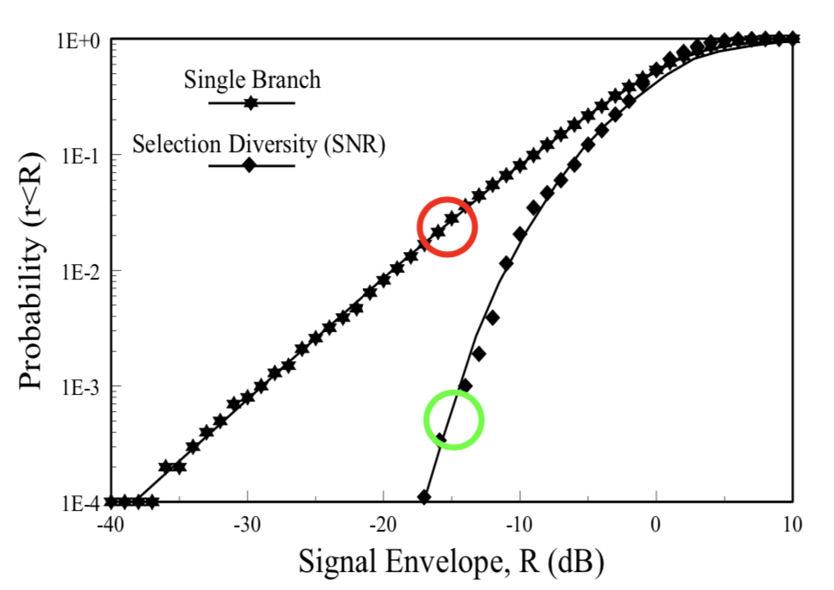
Diversity Improvement
Fading statistics with/without use of Selection Diversity (based on RSSI)
3%
Probability of fading lower than -15dB on the mean:
- 3% for single branch
- 0.06% for the two branches with selection diversity
0.06%

Slide 28
Overall
Switched (Scanning) Diversity - simple and cheap - current branch selected till it falls below threshold - fixed or variable threshold | Selection Diversity - more complex and expensive - scans branches and selects the one with highest RSSI - slightly better than switched diversity
Maximal Ratio Combining - signals are individually weighted and combined - pre-detection: signals co-phased before combining - optimises SNR - optimal technique | Equal Gain Combining - same weight to all signals - same gain (=1) for all signals - less complex than MRC - slightly worse performance compared to MRC

